Slide 1
How do Humans Evaluate Machine Translation?
Francisco Guzmán, Ahmed Abdelali, Irina Temnikova, Hassan Sajjad, Stephan Vogel

Slide 2
Machine Translation Evaluation
Task: Compare a system’s output to a source sentence and reference sentence
The evaluation can be based on:
Fluency and adequacy
Ranking

Slide 3
Example:
Source
Croácia sem capacidade para receber mais refugiados
Reference
Croatia without capacity to accept any more refugees
Translation
Croatia without capacity to receive more refugees

Slide 4
Common Issues
The task side
Difficult to distinguish between different aspects of translation such as grammar, syntax, etc.
No insight on how humans use different sources of information
The human side
Tedious task: evaluators can lose interest quickly
Evaluations are inconsistent and highly subjective
Notes:
----- Meeting Notes (9/14/15 17:29) -----
Formatting...

Slide 5


Black Box
Translations
Source
References
Score/
Ranking

Slide 6
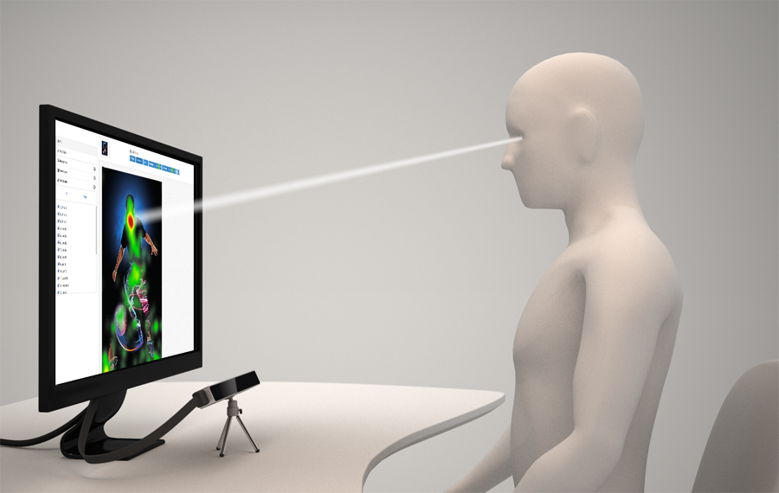
Study MT Evaluation as a Glass-Box
Sources of information
Source text
Translation
Reference
Background of evaluators
Monolingual (English speakers)
Bilingual (Spanish+English speakers)
Comparison
Time to complete the task
Consistency
Using eye tracking
Loose definition
Monolingual: Knowledge of Spanish insufficient to understand the source text

Slide 7
Questions to Answer
What is the most useful information for the evaluators?
Where do users spend more time?
Evaluating the translation?
Understanding the task?
What is the effect of evaluator’s background? Which evaluators are more consistent?
Notes:
----- Meeting Notes (9/14/15 17:29) -----
Title case
dash vs bullets

Slide 8
Experimental Setup

Slide 9
Participants
20
Evaluators
27 to 45 yrs old
85%
50%
20%
Computer scientists
Had experience translating documents
Had experience with MT evaluation
None of the co-authors of this paper were in the pool of subjects

Slide 10
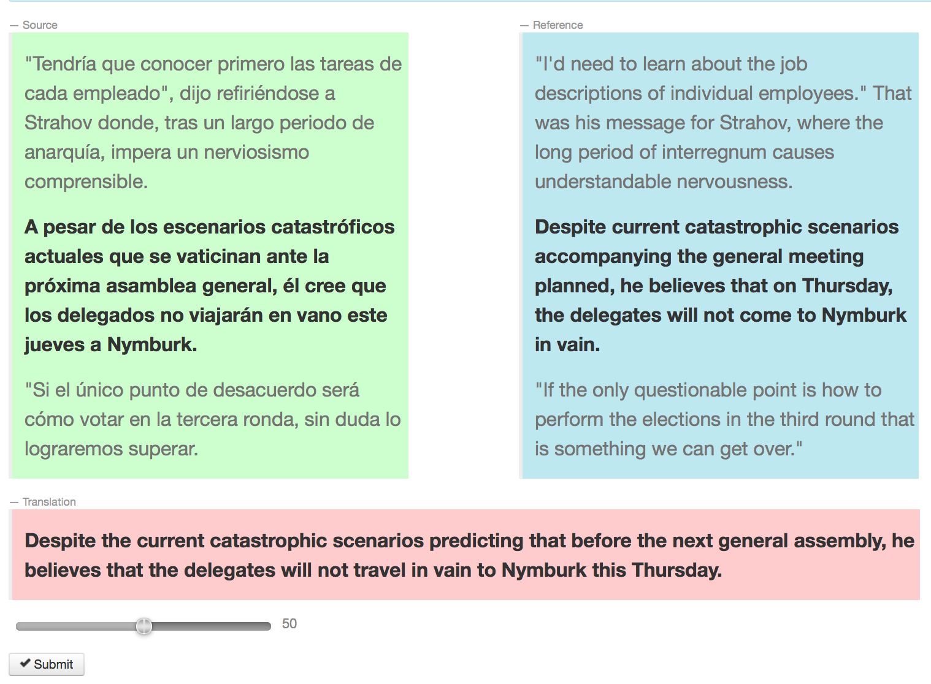
Interface
3 AOIs (Areas of Interest)
Source
(src)
Reference
(tgt)
Translation
Scorer

Slide 11
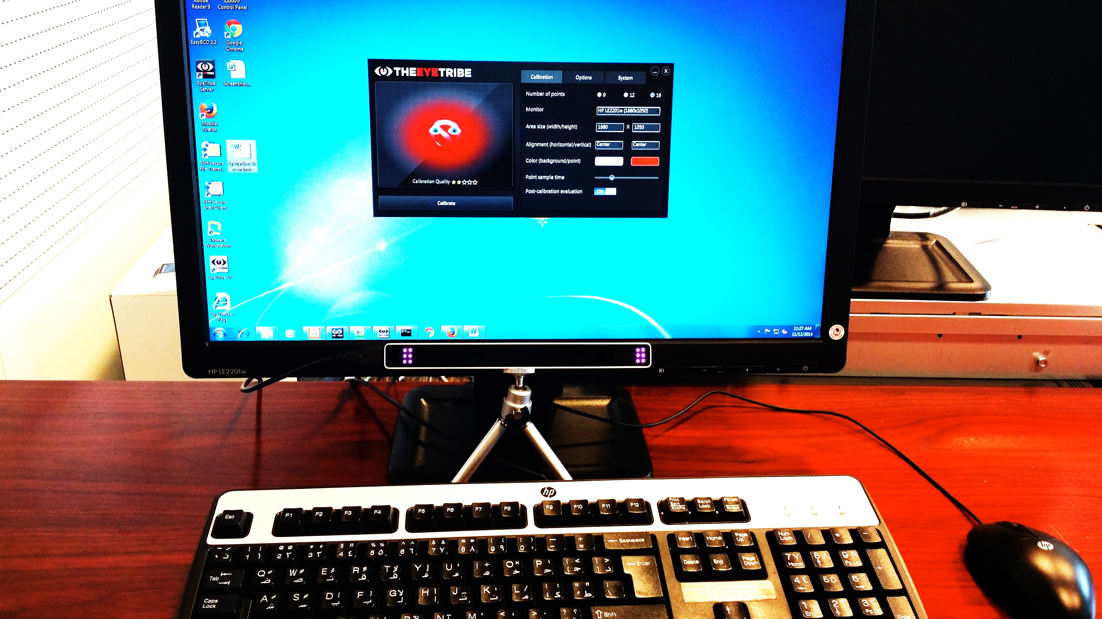
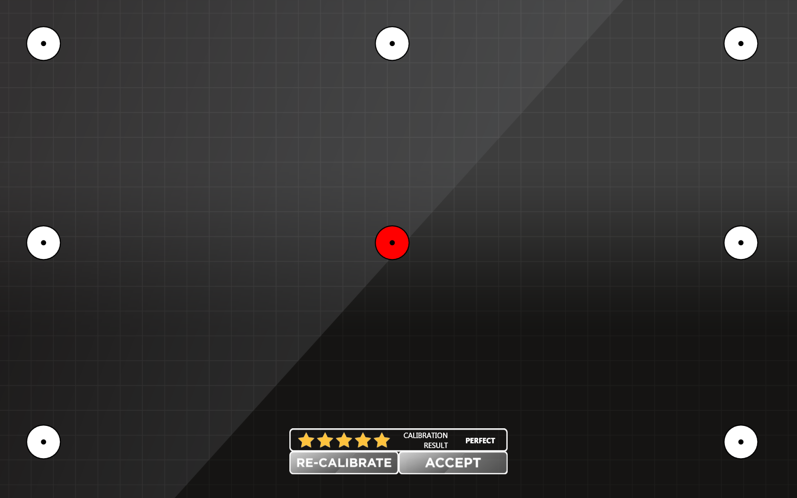
Eye-tracking Setup

Slide 12
Data
Spanish to English WMT12 evaluation data
3003 different source sentences, and references
12 different MT systems
1141 ranking annotations
In each annotation, evaluators ranked 5 out of the 12 systems
Selected sentences with most judgments
150 source sentences were chosen
Selected 2 translations per sentence (300 total)
Best and worst relative ranking
Created 4 tasks per translation (1200 total)
Notes:
----- Meeting Notes (9/14/15 17:29) -----
i.e. 12 space
150sentences, sufficient number of sentences.
no (i.e. )

Slide 13
Balanced experimental design
1200 evaluation tasks (300 translations x 4 replicates)
Users
Scenarios
Sentence length
(~10.18)
(~18.18)
(~30.88 words)
Notes:
----- Meeting Notes (9/14/15 17:29) -----
Each evaluated 4 times by different user

Slide 14
Experimental Design (per user)
60 evaluation tasks
Task scenario
Task sentence length
A user never saw the same translation (or related translations) twice

Slide 15
How to Compare the Performance?
Time
Measure the effective time (i.e. time spent in different areas)
Score consistency (variance)
Variability of the scores given by different evaluators (C) to the same translation, averaged across all translations (T)

Slide 16
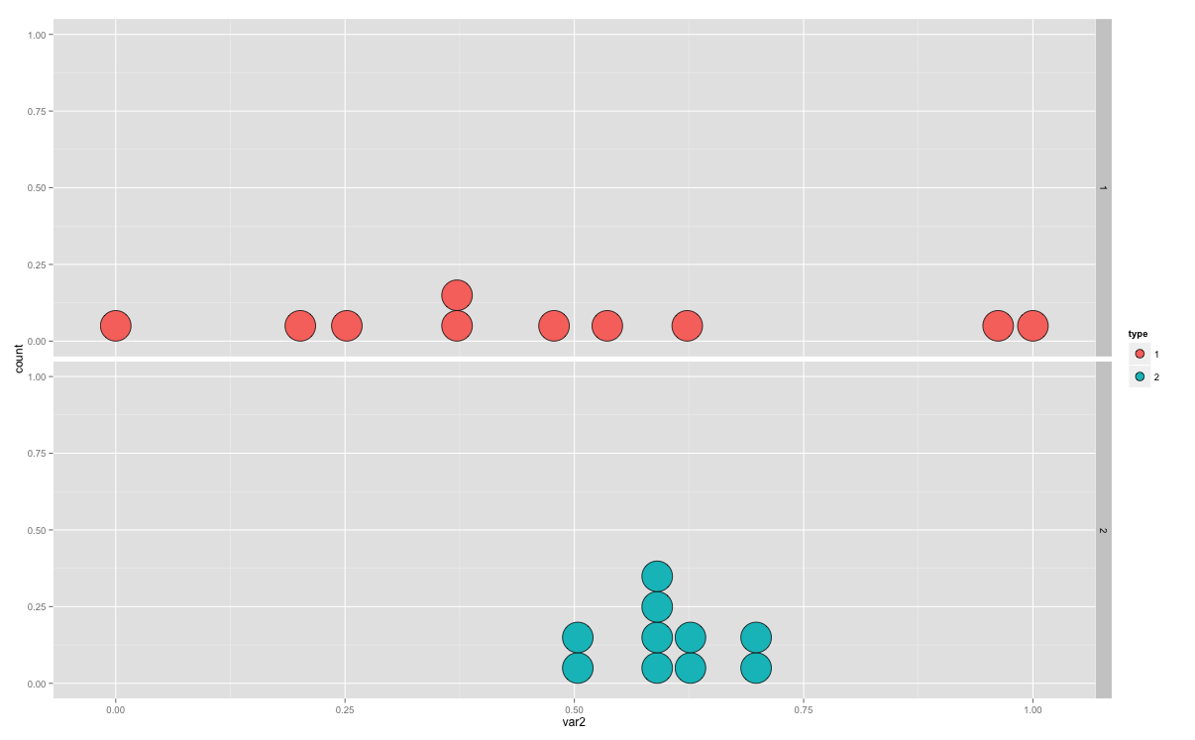
Score Consistency
Group A
Low consistency
|
0
|
100
Group averages
Group B
High consistency
|
0
|
100
Notes:
----- Meeting Notes (9/14/15 17:29) -----
add spread

Slide 17
Results

Slide 18
Time Spent in Each Scenario
Bilinguals are faster than monolinguals
Showing only the reference (tgt) is the fastest condition
Bilinguals spend about the same time in src vs. src+tgt
Key:
source only (src), source and reference (src+tgt), reference only (tgt)
Notes:
----- Meeting Notes (9/14/15 17:49) -----
Title case

Slide 19
Time vs. Source Sentence Length
Bilinguals are faster (again!)
Longer sentences take longer (expected)
Notes:
----- Meeting Notes (9/14/15 17:49) -----
alignment

Slide 20
Where do Evaluators Look?
Most of the time reading source or reference
Bilinguals spend less time reading the translation
Monolinguals spend a large proportion of time in source
Alternative strategies?
Spanish-English relatedness?
Notes:
----- Meeting Notes (9/14/15 17:49) -----
fix color sequences.
clean up text
ref=tgt in R

Slide 21
Consistency
Monolinguals show less variance than bilinguals
Monolinguals are most consistent in the tgt scenario
Bilinguals show more variance in tgt scenario
Possible lack of familiarity
Notes:
----- Meeting Notes (9/14/15 17:49) -----
change src src+tgt tgt colors

Slide 22
Summary
The bilinguals perform the tasks faster.
The bilinguals spend less time evaluating the translation.
The monolinguals are slower, but more consistent.
The more information is displayed in the screen, the longer it takes to complete the evaluation.

Slide 23
Our Recommendation
For human MT evaluation tasks
Scenario: only target language information (reference)
Evaluators: monolinguals

Slide 24

A grain of salt
Need to randomize the order of the scenarios
Replication is necessary in other languages
Does this hold for ranking-based evaluations?

Slide 25
Thank you!
Questions?
Data:
github.com/Qatar-Computing-Research-Institute/wmt15eyetracking
Eye-tracking enabled Appraise:
github.com/Qatar-Computing-Research-Institute/iAppraise

Slide 26
Why are Monolinguals More Consistent?
We can only speculate:
Bilinguals could formulate their own set of plausible translations making it more subjective
Monolinguals are constrained to a concrete representation
faster, more subjective
slower, less subjective

Slide 27
About Bilinguals in a Monolingual Setting
Why are there differences?
Hypothesis: order of the tasks encourages evaluators to learn different strategies

Slide 28
Do Evaluators Get Faster With Time?
Low correlation between task order and time to complete
src scenario
tgt scenario
src + tgt scenario

Slide 29
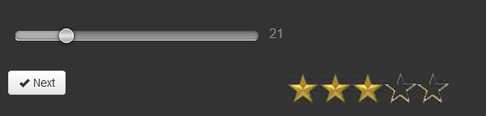
Feedback
Gamification of evaluation process
Provided feedback in form of “stars”
Feedback based on:
WMT human judgments
DiscoTK-party metric (winner of WMT14 metrics task)
Stars computed as relative distance to gold-score
Notes:
----- Meeting Notes (9/14/15 17:29) -----
[move to back up it]

Slide 30
Related work: Eyetracking
Doherty et al. (2010): Use eye-tracking to evaluate the comprehensibility of MT output in French
Stymne et al (2012): Apply eye-tracking to MT error analysis
Doherty and O’Brien (2014): Use eye-tracking to evaluate the usability of MT by an end user
Michael Carl : Eye-tracking in the translation process, post-editing

Slide 31
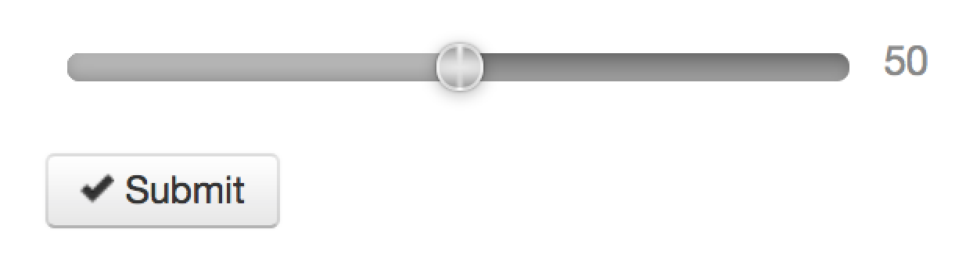
Evaluation
Only one translation at the time
Continuous score, “more natural”
Instructions were kept simple

